Slide 1
Secure Data Hiding in Images using Steganography
CAPSTONE PROJECT
Presented By: Karthikeya Ruthvik Pakki
Student Name : Karthikeya Ruthvik Pakki
College Name : VIT, Vellore
Department : Computer Science and Engineering (SCOPE)

Slide 2
OUTLINE
Problem Statement
Technology used
Wow factor
End users
Result
Conclusion
Git-hub Link
Future scope

Slide 3
Problem Statement
This project provides a secure way to hide and retrieve messages in images using steganography and password protection. OpenCV is used to embed the message within an image. The encrypted message remains concealed, ensuring confidentiality. Only users with the correct password can extract the hidden text. This enhances security by preventing unauthorized access. The approach combines encryption and image processing for effective data protection.

Slide 4
Technology used
Python is a versatile programming language used for implementing encryption, decryption, and image processing in this project.
OpenCV is a powerful image processing library that embeds and extracts hidden messages within images.
NumPy provides efficient array manipulation, aiding in handling image data and numerical operations.
PyQt6 is a GUI framework that enables user-friendly interaction for encrypting and decrypting messages in images.

Slide 5
Wow factors
Steganography-based encryption – Conceals messages within image pixels, making them nearly impossible to detect.
Password-protected decryption – Adds an extra layer of security, ensuring only authorized users can access the hidden message.
Graphical User Interface (GUI) – Provides an intuitive and user-friendly experience for seamless encryption and decryption.
No need for external storage – The message is embedded directly in the image, eliminating the need for separate storage.
Works with PNG images – Utilizes a lossless format to preserve image quality while securely storing encrypted messages.

Slide 6
End users
Journalists and Whistleblowers – Securely transmit sensitive information without detection.
Cybersecurity Professionals – Implement and test secure communication methods.
Government and Military Personnel – Protect classified messages from unauthorized access.
General Users – Safeguard personal messages from prying eyes.
Researchers and Academics – Study and develop advanced steganography techniques.

Slide 7
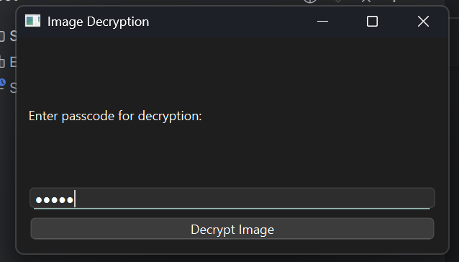
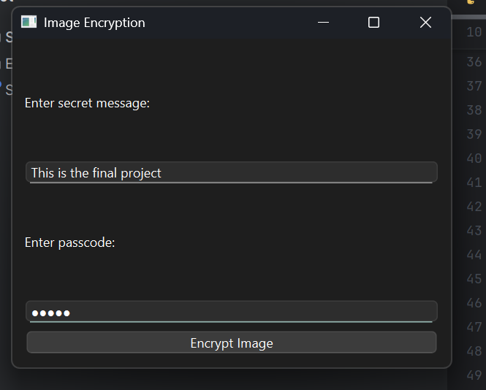
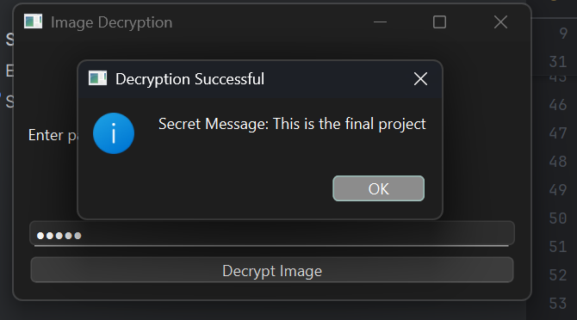
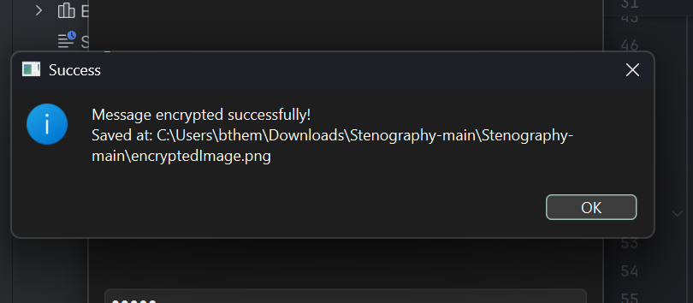
Results

Slide 8
Conclusion
The project successfully implements steganography-based encryption, allowing users to securely hide messages within images. The results demonstrate:
Effective Message Concealment – The encrypted text remains undetectable within the image pixels.
Secure Access with Password Protection – Only authorized users can retrieve the hidden message.
Preserved Image Quality – PNG format ensures lossless storage without noticeable visual changes.
Efficient Processing – OpenCV and NumPy enable fast embedding and extraction.
User-Friendly Interaction – PyQt6 provides an intuitive GUI for seamless encryption and decryption.

Slide 9
GitHub Link
https://github.com/Ruthvik-Pakki/Secure-Data-Hiding-in-Images-using-Steganography

Slide 10
Future scope(optional)
Support for multiple image formats – Expanding compatibility to include JPG, BMP, and other formats for broader usability.
Implementation of AES encryption – Enhancing security with advanced encryption standards to further protect hidden messages.
Development of a mobile and web application – Making the system accessible across multiple platforms for convenience.
AI-based image security and tampering detection – Integrating AI to detect unauthorized modifications and enhance data integrity.

Slide 11
THANK YOU

